Slide 1
Multilayer Percetrons
091601
  by Huafu Chen
SLST, UESTC, China
Notes:
NN 3
11-00
Elena Marchiori
cha

Slide 2
Multilayer Perceptrons
Architecture
Input
layer
Output
layer
Hidden Layers

Slide 3
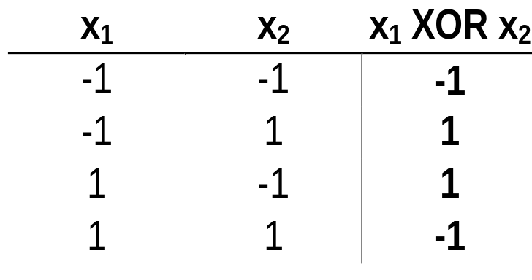
A solution for the XOR problem
x₁
1
-1
1
x₂
-1
-1
0.1
x₁
+1
+1
1 if v > 0
ϕ(v) =
-1 if v ≤ 0
ϕ is the sign function
-1
-1
x₂
+1
+1
-1
Notes:
NN 3
11-00
Elena Marchiori
(on Book page 177-Figure 4.8, there is another form for XOR)
Here each neuron is represented by a McCulloch-Pitts model, which uses a threshold function for its activation function

Slide 4
A solution for the XOR problem
x₁
1
-1
1
x₂
-1
-1.5
-0.5
x₁
+1
-2
1 if v > 0
ϕ(v) =
-1 if v ≤ 0
ϕ is the sign function
+1
+1
x₂
+1
+1
-0.5

Slide 5
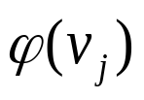
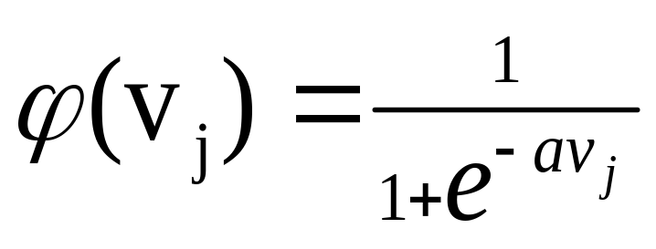

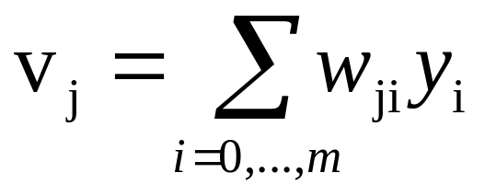

NEURON MODEL
Sigmoidal Function
induced field of neuron j
Most common form of activation function
a →∞ ⇒ ϕ → threshold function
Differentiable
1
Increasing a
-10 -8 -6 -4 -2 2 4 6 8 10
Notes:
NN 3
11-00
Elena Marchiori
Freeman etal 1970s’ 神经元的 平均发放率(the mean firing rates ,即冲击密度（pulse densities）) 与细胞体电位的关系为sigmoid函数，firing rates = sigmoid function (neuron body potential), 反过来的函数形状也差不多

Slide 6
LEARNING ALGORITHM
Back-propagation algorithm
It adjusts the weights of the NN in order to minimize the average squared error.
Function signals
Forward Step
Error signals
Backward Step
j

Slide 7
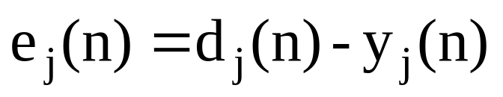
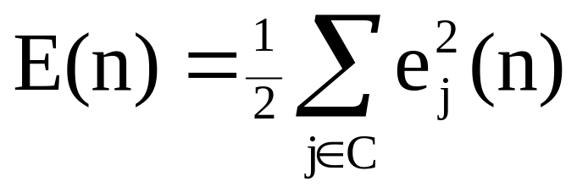
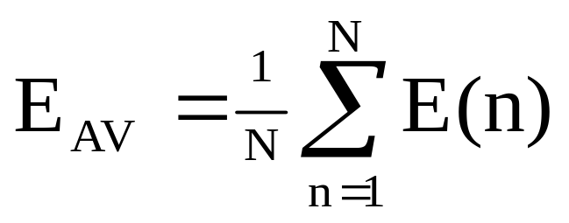
Average Squared Error
Error signal of output neuron j at presentation of n-th training examples(n=1,…N):
Total energy at time n:
page 161-(4.2)
Average squared error:
Measure of learning
performance(Goal):
Adjust weights of NN to minimize E_{AV}
C: Set of neurons
in output layer
N: size of training set
Notes:
NN 3
11-00
Elena Marchiori
Average squared error
--- batch mode

Slide 8


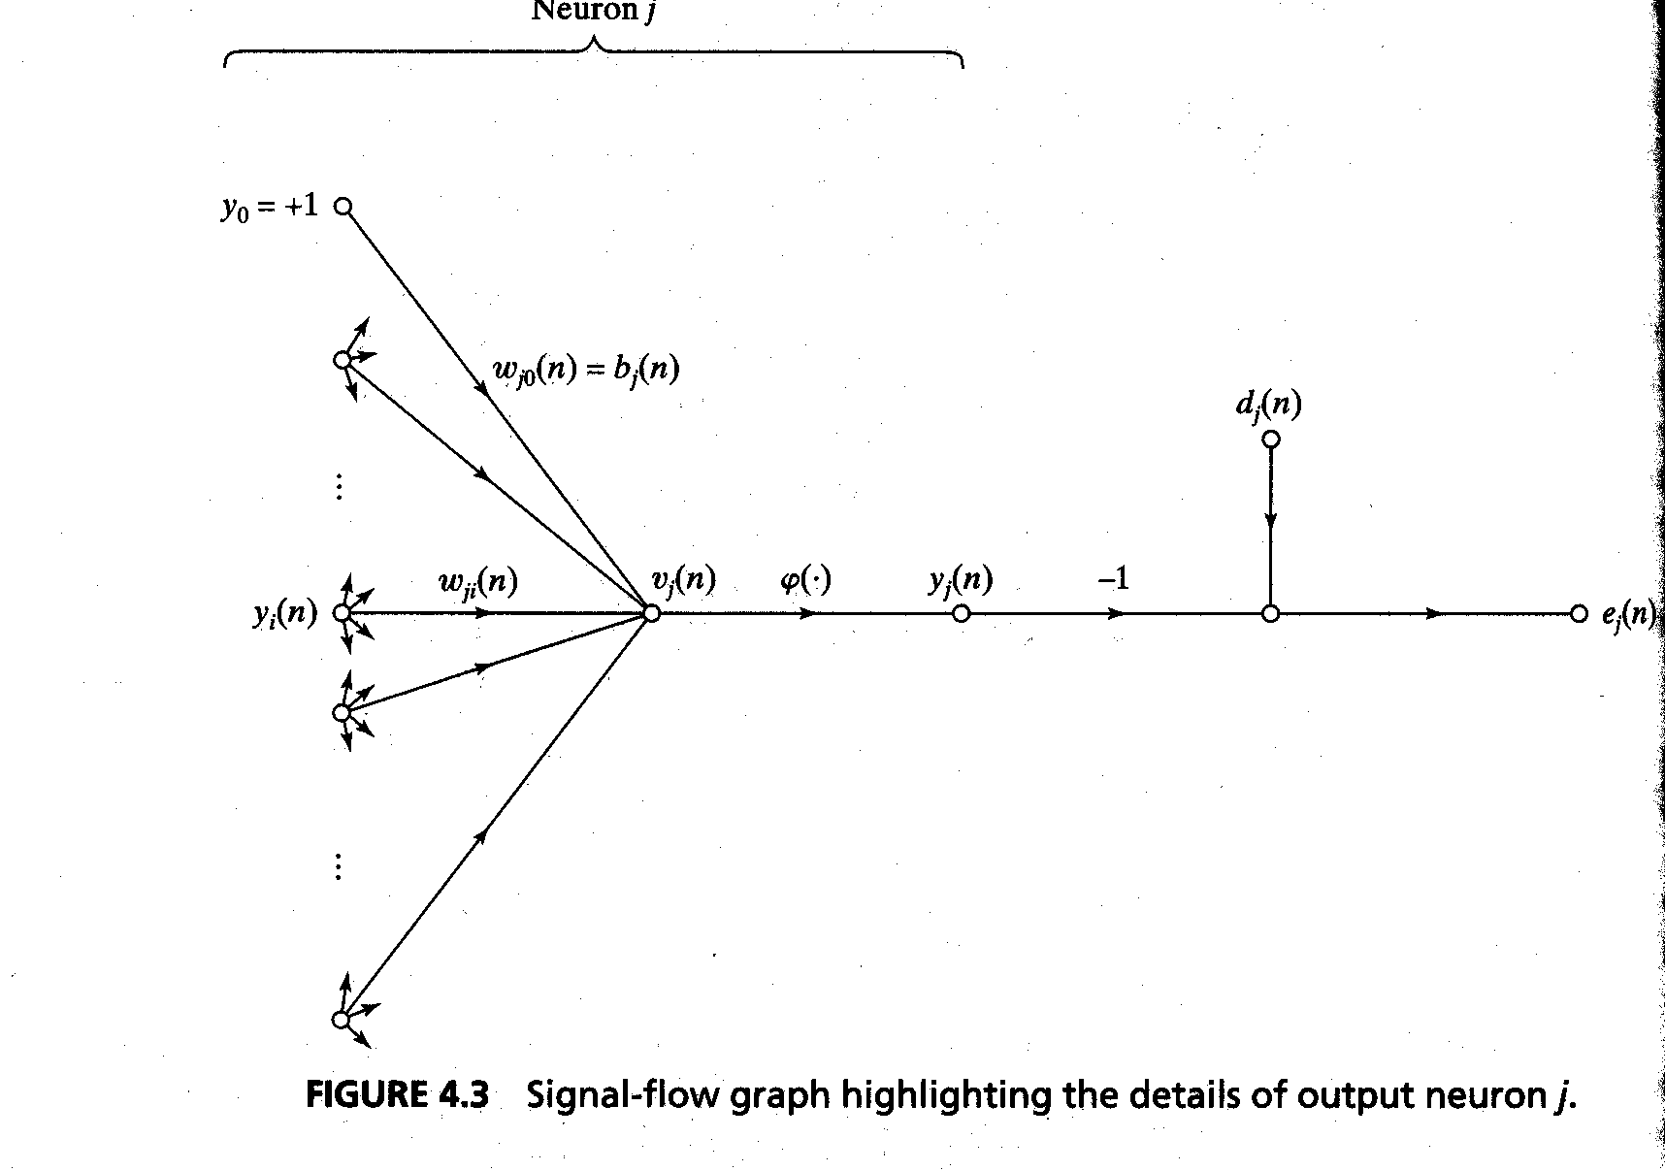
Notation
Error at output of neuron j
Output of neuron j
Induced local field of neuron j by all m neurons in the former stage (i)
(4.4)

Slide 9
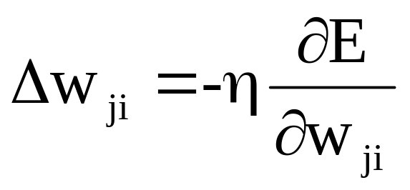
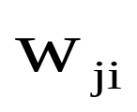
Weight Update Rule
Update rule is based on the gradient descent method
take a step in the direction yielding the maximum
decrease of E: Delta rule
In last lecture (steepest descent):
∇E(w)=g (notation) (3.11)
w(n+1)=w(n)- ηg (3.12)
Step in direction opposite to the gradient
With weight associated to the link from neuron i
to neuron j

Slide 10
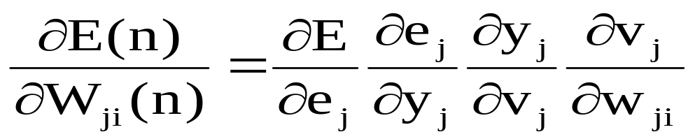
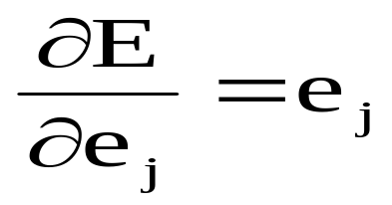
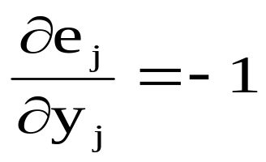
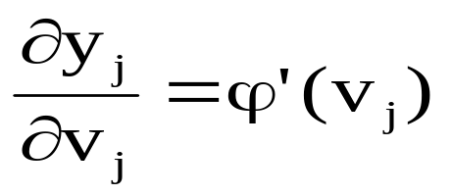
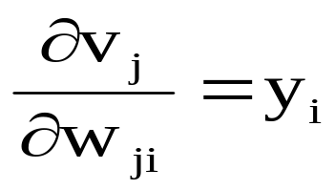
Chain rule of calculus

Slide 11
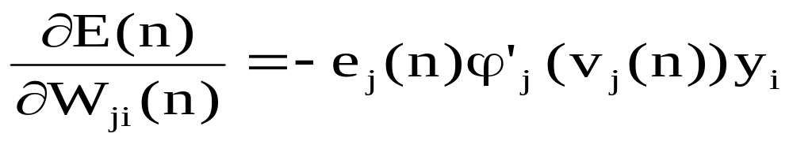
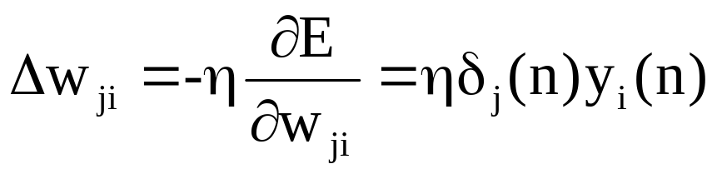
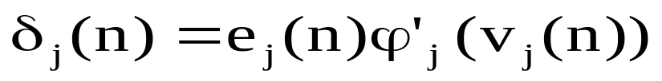
Result

Slide 12
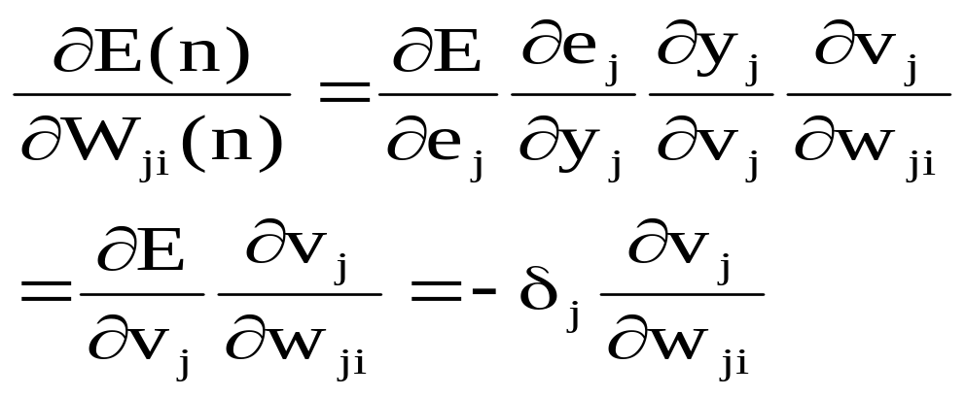
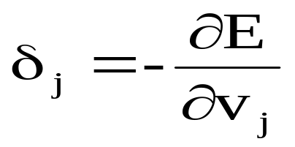
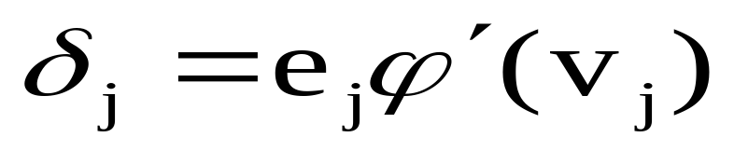
Reorganization of the above derivations
Definition of the Local Gradient of neuron j
Local Gradient:

Slide 13
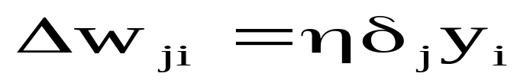
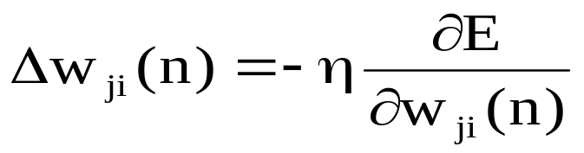
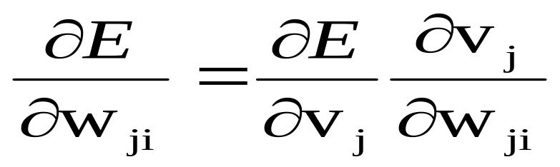
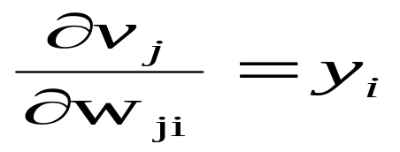
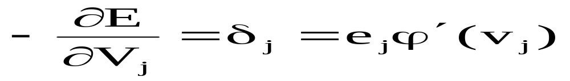
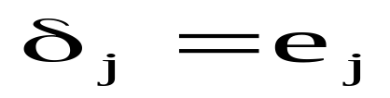
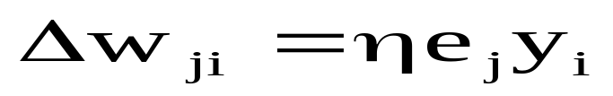
Update Rule
In summary:
--------------------------------------------
Summary in details:
The delta rule:
For a linear Neuron:
p.129 (3.37) LMS

Slide 14
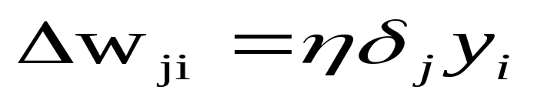
Compute local gradient of neuron j
From j to i, if we know delta, we know the update
The key factor is the calculation of e_{j}
There are two cases:
        Case 1): j is a output neuron
        Case 2): j is a hidden neuron
Notes:
NN 3
11-00
Elena Marchiori
Delta rule

Slide 15
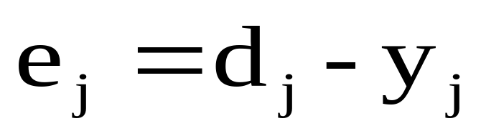
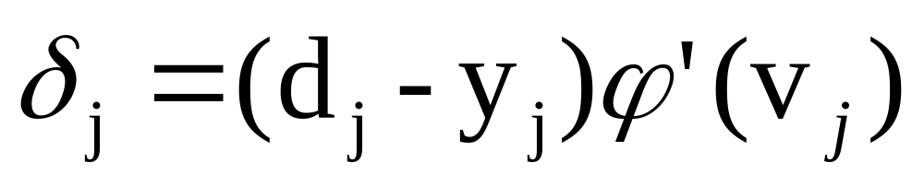
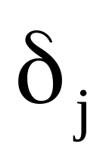
Error e_{j} of output neuron
Case 1: j output neuron
Then
(4.14)
Is a variable related to the “error”

Slide 16
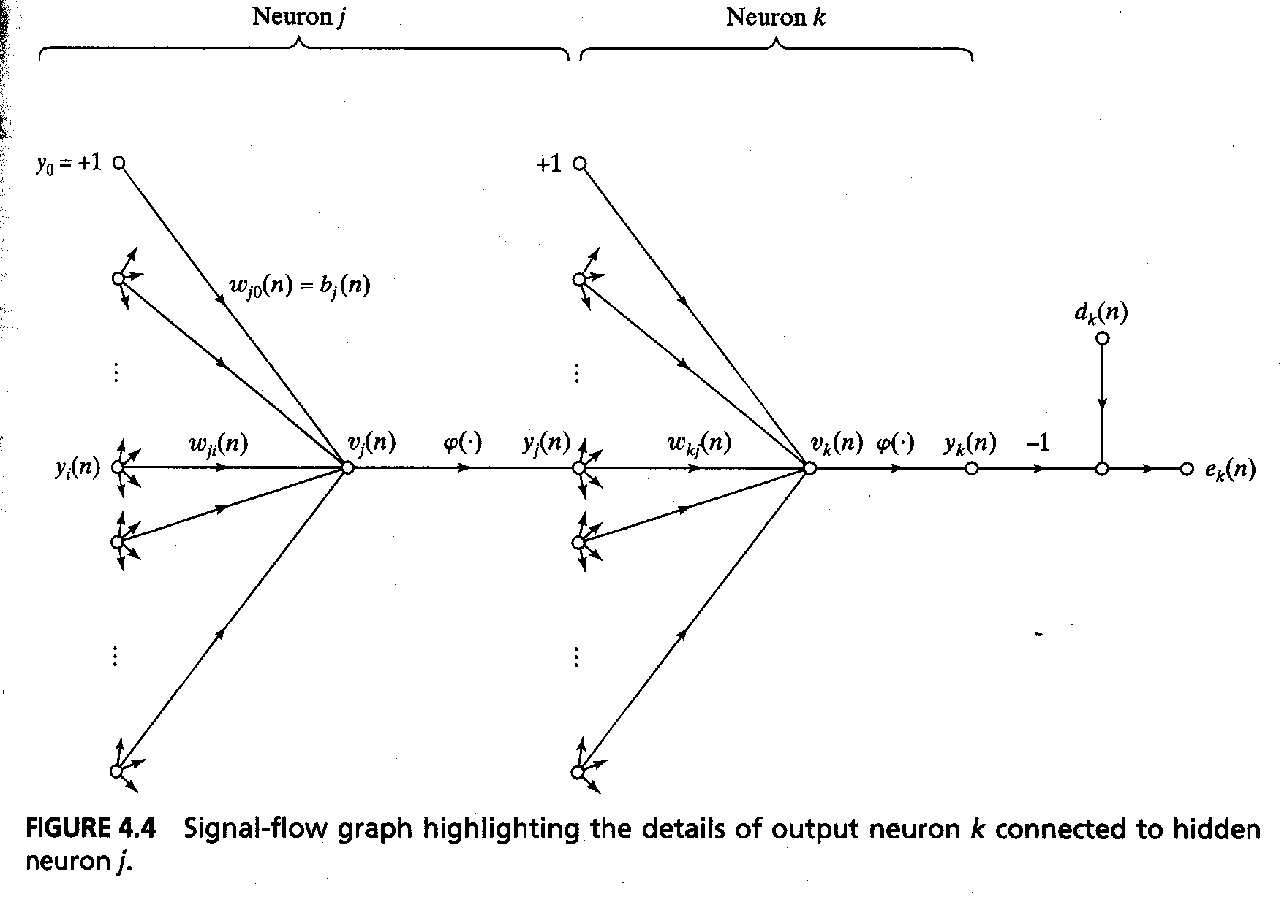
Local gradient of hidden neuron
Case 2: j hidden neuron

Slide 17
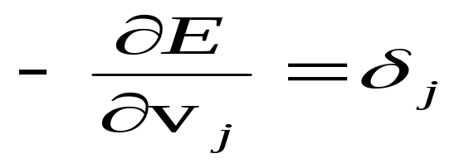
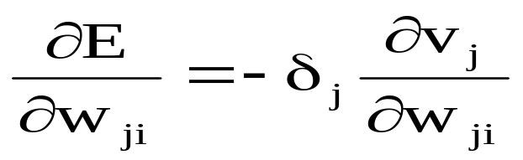

The Gradient Descent
The delta rule:
Is the key variable

Slide 18
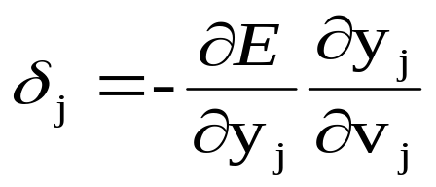
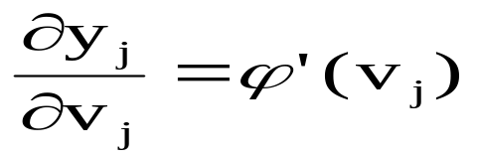
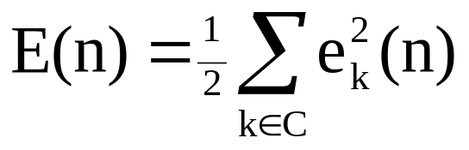
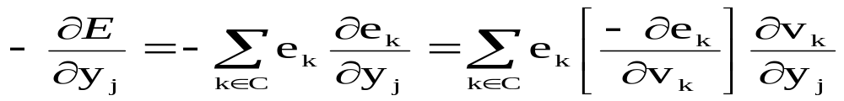
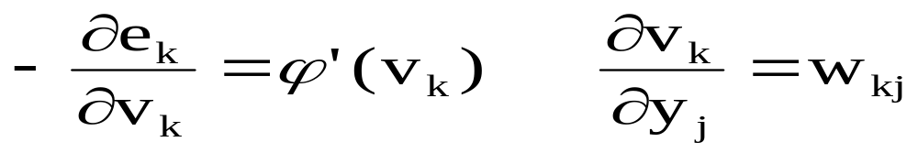
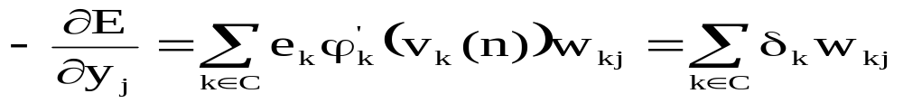
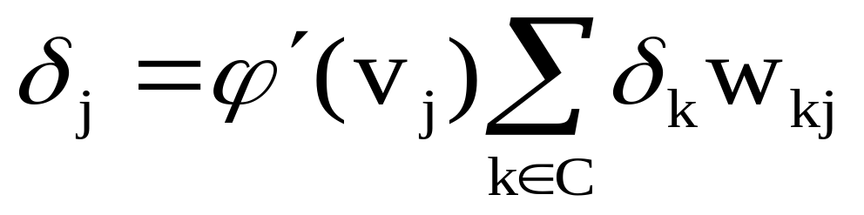
Use the Chain Rule
C: Set of neurons in output layer
from
We obtain

Slide 19
Local Gradient of hidden neuron j
(4.24)
w_{1j}
e₁
Signal-flow graph of back-propagation error signals to neuron j
δ₁
ϕ’(v₁)
δ_{j}
ϕ’(v_{j})
w_{kj}
e_{k}
ϕ’(v_{k})
δ_{k}
w_{m j}
e_{m}
δ_{m}
ϕ’(v_{m})
the local gradient for neuron j is recursively determined in terms of the local gradients of all neurons to which neuron j is directly connected

Slide 20
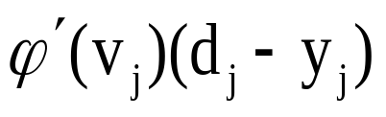
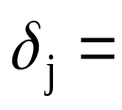
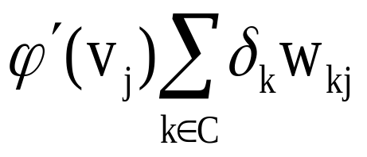
Delta Rule
In summary:
Delta rule Δw_{ji} = ηδ_{j} y_{i}
(4.13)
IF j output node
(4.14)
IF j hidden node
(4.24)
C: Set of neurons in the layer following the one containing j
In summary:
by (4.14) and (4.24), according to (4.13) to modify the synaptic weights
Notes:
NN 3
11-00
Elena Marchiori
Delta rule/error correction learning: LMS page 129, w(n+1)=w(n)+’learning rate’x(n)e(n)

Slide 21
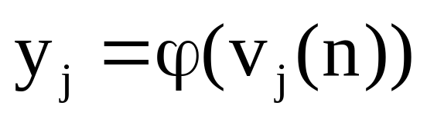
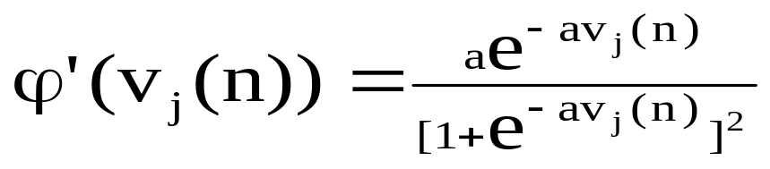
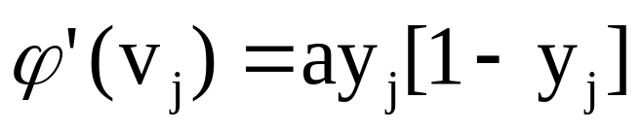
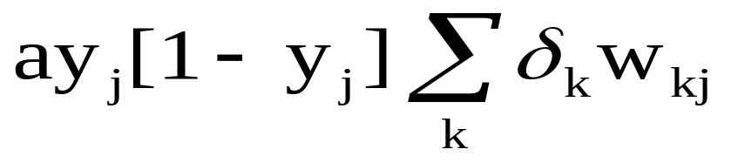

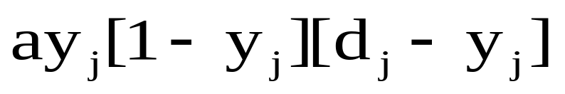
Local Gradient of neurons
For Logistic Function
(4.31)
,
We have
a > 0
(4.32)
if j hidden node
(4.33)
If j output node
(4.34)

Slide 22
Backpropagation algorithm
Two phases of computation:
  Forward pass: run NN and compute the error for each neuron of the output layer.
  Backward pass: start at the output layer, and pass the errors backwards through the network, layer by layer, by recursively computing the local gradient of each neuron.

Slide 23

Summary
Notes:
NN 3
11-00
Elena Marchiori
上排： feed-forward to get the desired output
Lower row: back-propagation to get the delta error

Slide 24
Summary of the Back-Propagation algorithm(P122)
Initialization
Presentation of training examples
Forward computation
Backward computation

Slide 25
Heuristics for making the back-propagation algorithm
Sequential versus batch update
Maximizing information content
Activation function
Target values
Normalizing the inputs
Initialization
Learning form hints
Learning rates

Slide 26


Output representation and decision rule
Pattern classifier
Minimizes the empirical risk functional:
Y1,j
Y2,j
Y3,j
xj
Multilayer
Perception

Slide 27
Training
Sequential mode (on-line, pattern or stochastic mode):
  (x(1), d(1)) is presented, a sequence of forward and backward computations is performed, and the weights are updated using the delta rule.
  Same for (x(2), d(2)), … , (x(N), d(N)).

Slide 28
Training
Batch mode
The learning process continues on an epoch-by-epoch basis until the stopping condition is satisfied.
From one epoch to the next choose a randomized ordering for selecting examples in the training set.
Notes:
NN 3
11-00
Elena Marchiori
上面的介绍是按 sequential 方式的，如果按 batch方式，实际即 把 一批的平均误差作为一次的误差

Slide 29
Stopping criterions
Sensible stopping criterions:
  Average squared error change:
  Back-prop is considered to have converged when the absolute rate of change in the average squared error per epoch is sufficiently small (in the range [0.1, 0.01]).
  Gradient vector change:
  The BP algorithm is considered to have converged when the Euclidean norm of the gradient vector reaches a sufficiently small gradient threshold.
  Generalization based criterion:
  After each epoch the NN is tested for generalization. If the generalization performance is adequate then stop.
Notes:
NN 3
11-00
Elena Marchiori
Average squared error change:
Back-prop is considered to have converged when the absolute rate of change in the average squared error per epoch is sufficiently small (in the range [0.1, 0.01]).(See this ppt,page.6)

Slide 30

Early stopping Method of Training
A periodic “estimation-followed-by-validation” process proceeds as follows:
After a period of estimation (training), the synaptic weights and bias levels of the multilayer perceptron are all fixed, and the network is operated in its forward mode. The validation error is thus measured for each example in the validation subset.
When the validation phase is completed, the estimation (training) is resumed for another period, and the process is repreated.

Slide 31
Generalization
Generalization: NN generalizes well if the I/O mapping computed by the network is nearly correct for new data (test set).
Factors that influence generalization:
  the size of the training set.
  the architecture of NN.
  the complexity of the problem at hand.
Overfitting (overtraining): when the NN learns too many I/O examples it may do so by finding a feature (due to noise, for example) that is present in the training data but not true of the underlying function that is to be modeled.
Notes:
NN 3
11-00
Elena Marchiori

Slide 32

Generalization

Slide 33
Expressive capabilities of NN
Continuous functions:
Every bounded continuous function can be approximated with arbitrarily small error, by network with one hidden layer
Any function can be approximated with arbitrary accuracy by a network with two hidden layers
Notes:
NN 3
11-00
Elena Marchiori
Boolean functions:
Every boolean function can be represented by network with single hidden layer
but might require exponential hidden units

Slide 34

Generalized Delta Rule
If η small ⇒ Slow rate of learning
If η large ⇒ Large changes of weights
⇒ NN can become unstable (oscillatory)
Method to overcome above drawback: include a momentum term in the delta rule
Generalized delta function
momentum constant

Slide 35
Generalized delta rule
the momentum accelerates the descent in steady downhill directions.
the momentum has a stabilizing effect in directions that oscillate in time.

Slide 36
η adaptation
Heuristics for accelerating the convergence of
the back-prop algorithm through η adaptation:
Heuristic 1: Every weight should have its own η.
Heuristic 2: Every η should be allowed to vary from one iteration to the next.
Notes:
NN 3
11-00
Elena Marchiori
Heuristic 启发

Slide 37
Setting the parameters
How are the weights initialized?
How is the learning rate chosen?
How many hidden layers and how many neurons?
Which activation function ?
How to preprocess the data ?
How many examples in the training data set?

Slide 38
Some heuristics (1)
Sequential .vs. Batch algorithms:
the sequential mode (pattern by pattern) is computationally faster than the batch mode (epoch by epoch)

Slide 39
Some heuristics (2)
Maximization of information content:
every training example presented to the backpropagation algorithm must maximize the information content.
  The use of an example that results in the largest training error.
  The use of an example that is radically different from all those previously used.

Slide 40



Some heuristics (3)
Activation function: network learns faster with antisymmetric functions when compared to nonsymmetric functions.
Sigmoidal function is
nonsymmetric
Hyperbolic tangent
function is
antisymmetric when
a=1.7159,b=2/3

Slide 41

Some heuristics
(3)

Slide 42
Some heuristics (4)
Target values: target values must be chosen within the range of the sigmoidal activation function.
Otherwise, hidden neurons can be driven into saturation which slows down learning

Slide 43
Some heuristics (5)
Inputs normalisation:
  Each input variable should be processed so that the mean value is small or close to zero or at least very small when compared to the standard deviation.
  Input variables should be uncorrelated ( by PCA see chapter 8).
  Decorrelated input variables should be scaled so their covariances are approximately equal.

Slide 44

Some heuristics (5)

Slide 45
Some heuristics (6)
Initialization of weights:
  If synaptic weights are assigned large initial values neurons are driven into saturation. Local gradients become small so learning rate becomes small.
  If synaptic weights are assigned small initial values, algorithms operate around the origin.

Slide 46

Some heuristics (6)
Weights must be initialised
for the standard deviation of the local induced field v lies in the transition between the linear and saturated parts.
To have a mean of zero and a variance equal to
m=number of weights
Notes:
NN 3
11-00
Elena Marchiori
Variance of V and w,

Slide 47
Some heuristics (7)
Learning rate:
  The right value of η depends on the application. Values between 0.1 and 0.9 have been used in many applications.
  Other heuristics adapt η during the training as described in previous slides.

Slide 48
Some heuristics (8)
How many layers and neurons
  The number of layers and of neurons depend on the specific task. In practice this issue is solved by trial and error.
  Two types of adaptive algorithms can be used:
    start from a large network and successively remove some neurons and links until network performance degrades.
    begin with a small network and introduce new neurons until performance is satisfactory.

Slide 49
Some heuristics (9)
How many training data ?
  Rule of thumb: the number of training examples should be at least five to ten times the number of weights of the network.

Slide 50
Output representation and decision rule
M-class classification problem
Y_{k,j}(x_{j})=F_{k}(x_{j}), k=1,...,M
Y_{1,j}
MLP
Y_{2,j}
Y_{M,j}
Notes:
NN 3
11-00
Elena Marchiori
多少类 用多少输出单元，在每一个输入时，只有一个取最大值

